Slide 1
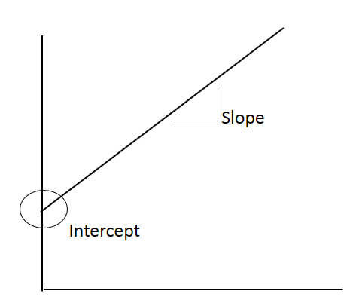
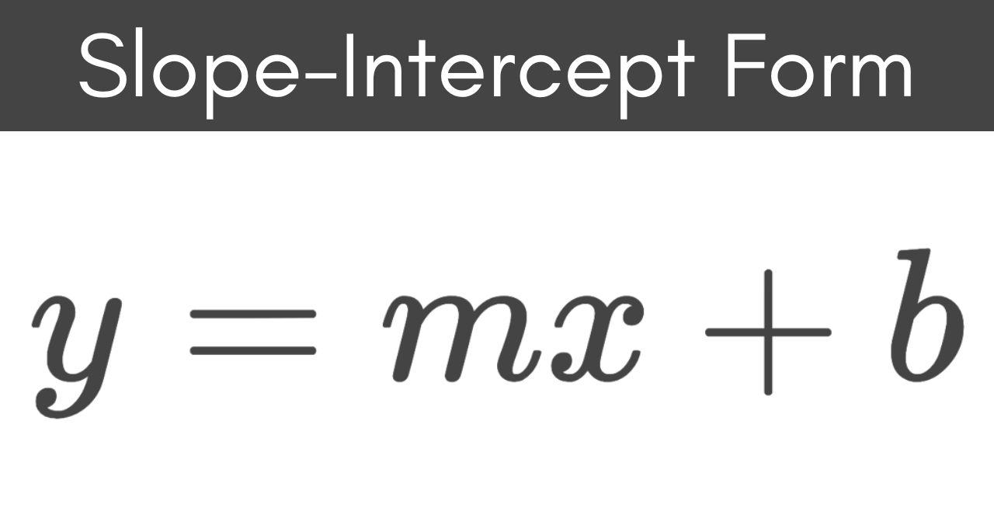




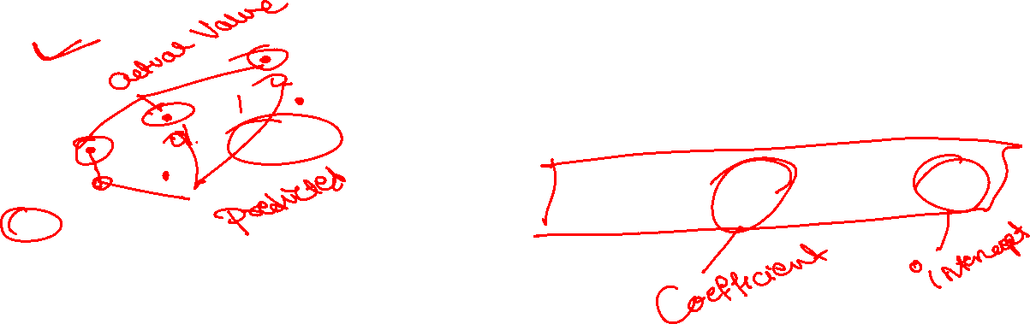
Ordinary Least Square (OLS)
Linear Regression
( How to get formula for calculate Slope & Intercept )
Subscribe to VKS Sir Join: Telegram Channel(VKS Sir (YOUTUBE)

Slide 2
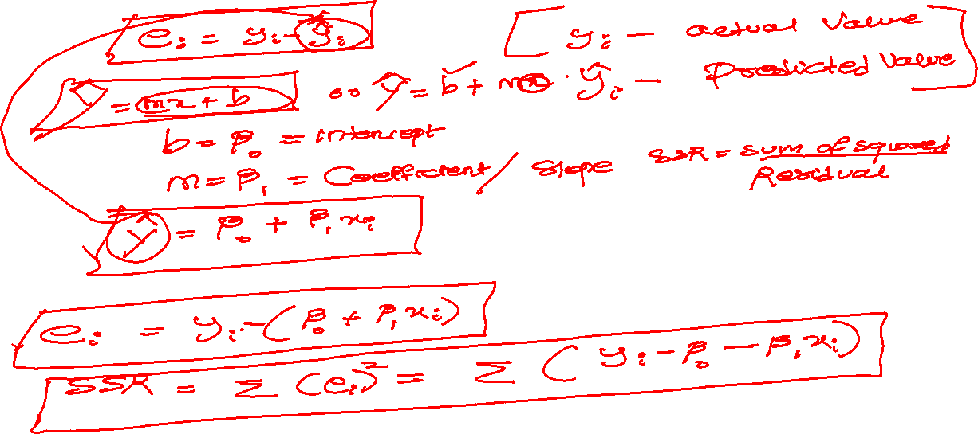
Subscribe to VKS Sir Join: Telegram Channel(VKS Sir (YOUTUBE)

Slide 3
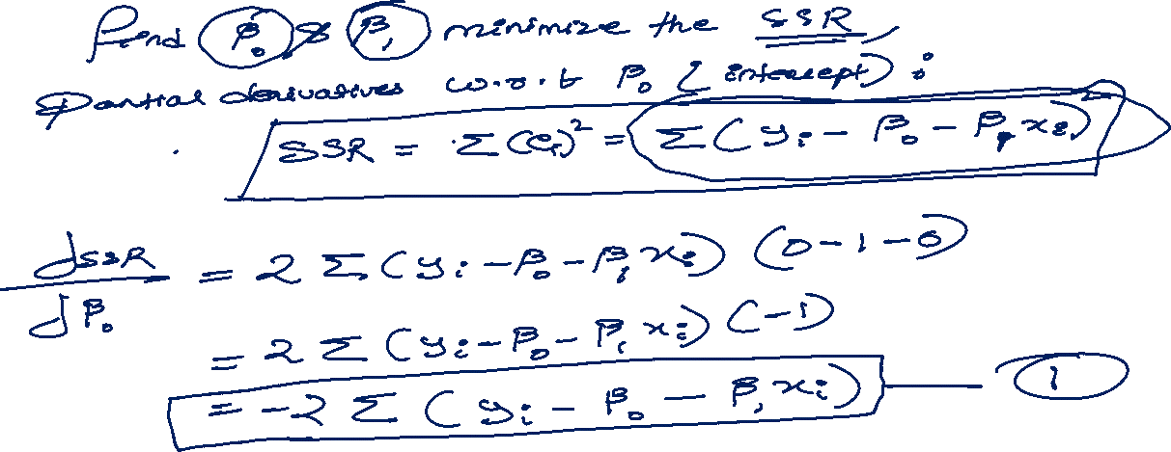
Subscribe to VKS Sir Join: Telegram Channel(VKS Sir (YOUTUBE)

Slide 4
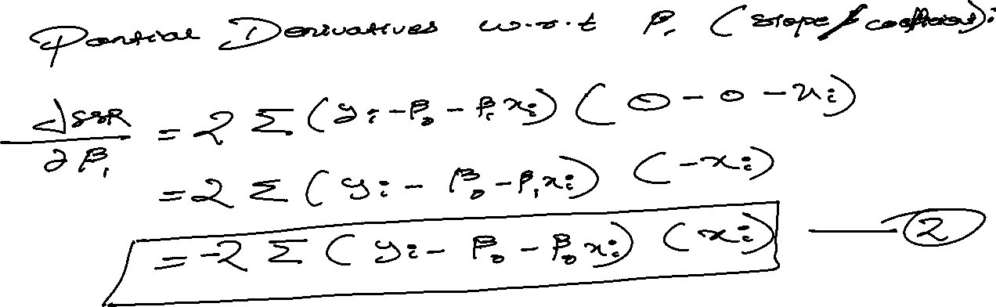
Subscribe to VKS Sir Join: Telegram Channel(VKS Sir (YOUTUBE)

Slide 5
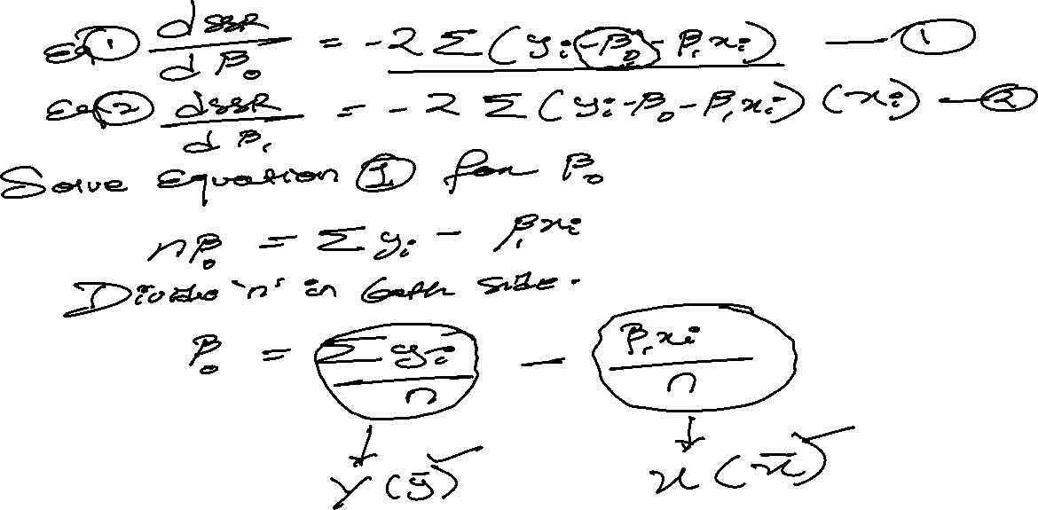
Subscribe to VKS Sir Join: Telegram Channel(VKS Sir (YOUTUBE)

Slide 6
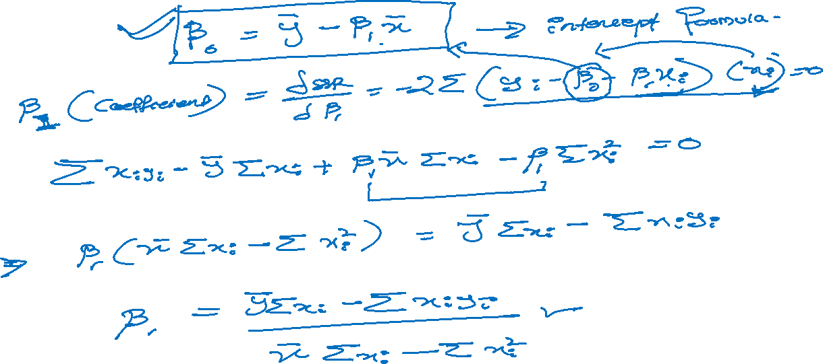
Subscribe to VKS Sir Join: Telegram Channel(VKS Sir (YOUTUBE)

Slide 7
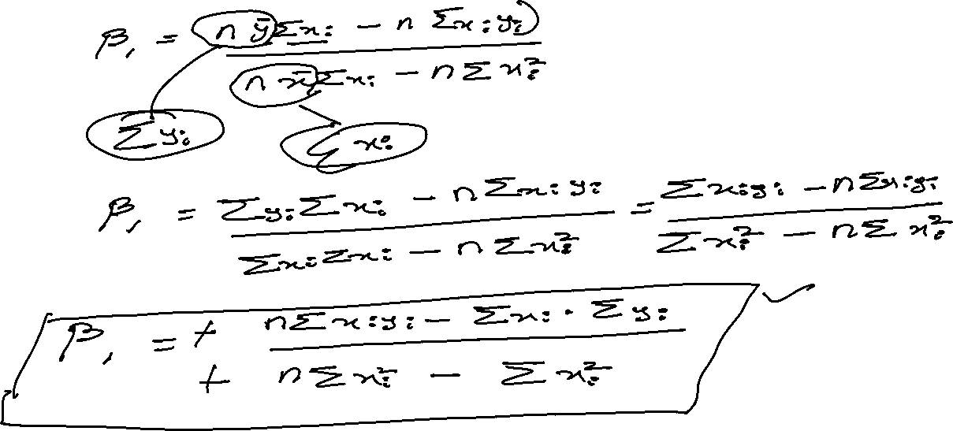
Subscribe to VKS Sir Join: Telegram Channel(VKS Sir (YOUTUBE)

Slide 8
Subscribe to VKS Sir Join: Telegram Channel(VKS Sir (YOUTUBE)

Slide 9
Subscribe to VKS Sir Join: Telegram Channel(VKS Sir (YOUTUBE)

Slide 10
Subscribe to VKS Sir Join: Telegram Channel(VKS Sir (YOUTUBE)

Slide 11
Subscribe to VKS Sir Join: Telegram Channel(VKS Sir (YOUTUBE)

Slide 12
Subscribe to VKS Sir Join: Telegram Channel(VKS Sir (YOUTUBE)

